Slide 1


The Physics of Music
By Ethan Eunchan Oh

Slide 2

What is music?

Slide 3
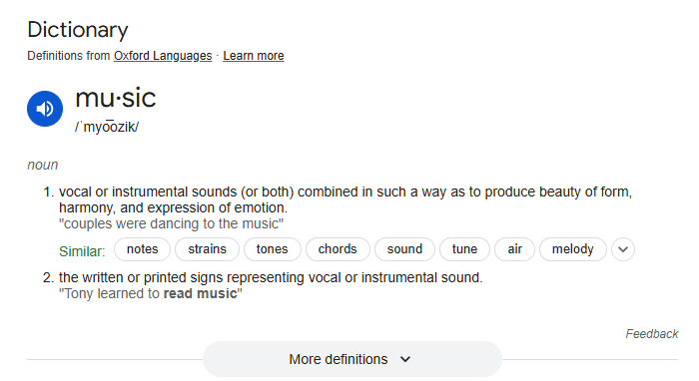
What is music?

Slide 4

Sound, What is it?

Slide 5

Waves, they are found all around us

Slide 6
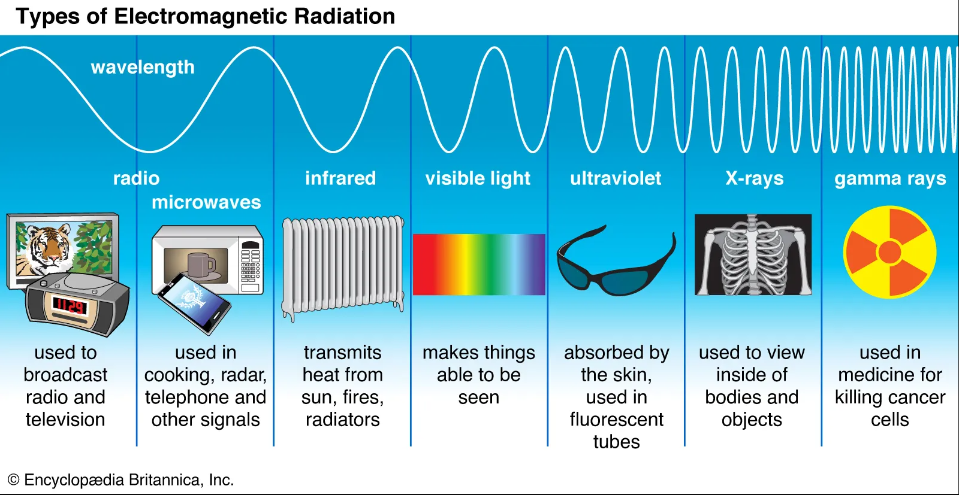
Waves, they are found all around us

Slide 7
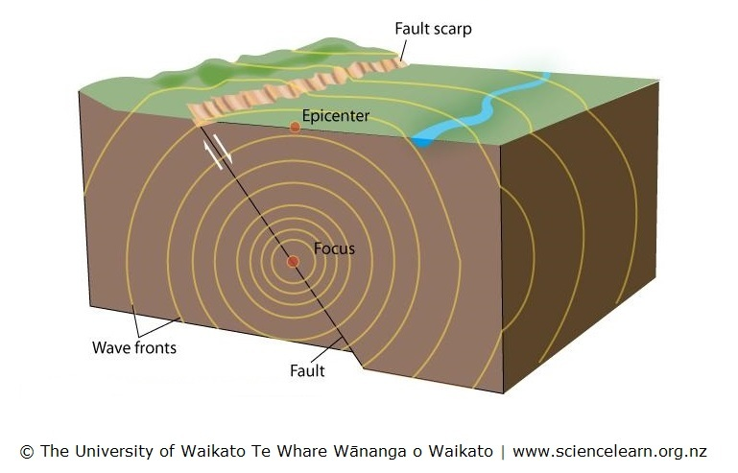
Waves, they are found all around us

Slide 8
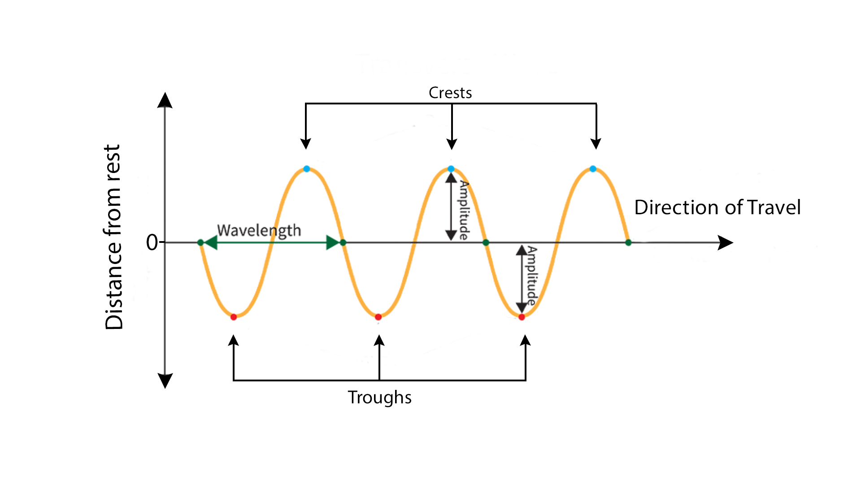
The Physics of Sound: Waves
The wavelength affects the pitch
The amplitude affects the volume
A period is the time it takes for a full wavelength to “cycle” through
A frequency is the amount of wavelengths that pass per second (hz)
Middle C is 261.6Hz

Slide 9
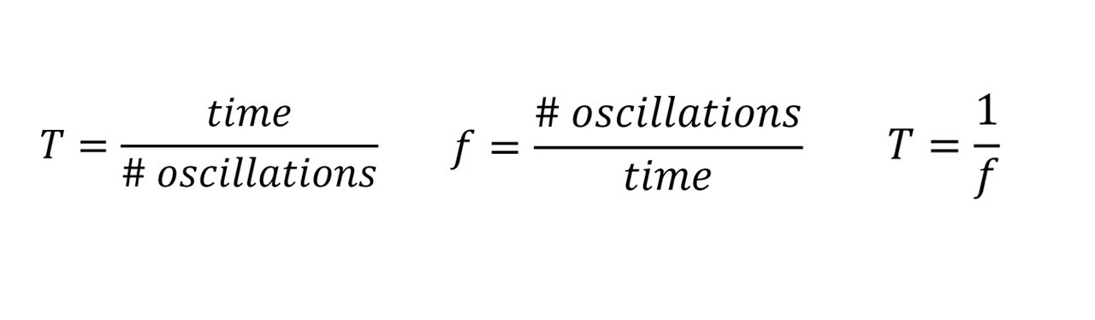
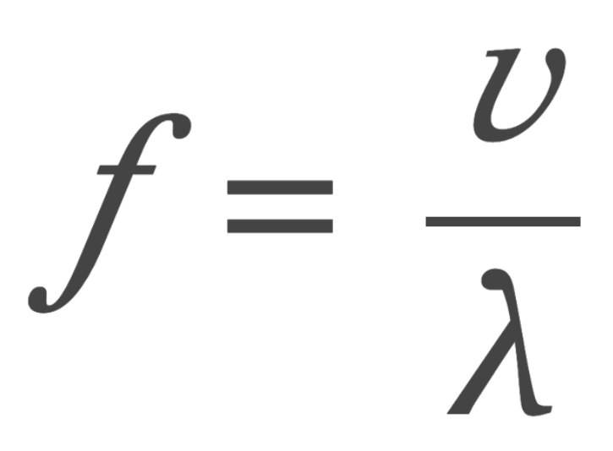
Period, Frequency, and Wavelength

Slide 10
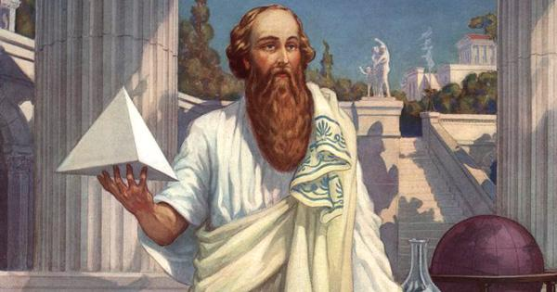
Legend of Pythagoras (yes its the triangle guy)

Slide 11
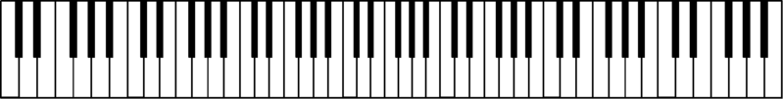
Pythagorean ratios
We hear a 2:1 frequency ratio as the same pitch class.
C3 = 130.8Hz, C4 = 261.6Hz, C5 = 523.2Hz
Simple ratios are pleasing and are consonant 2:1, 3:2, 4:3
Dissonant intervals like 262144:177147 sound dissonant

Slide 12
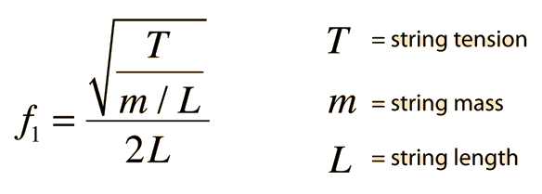


Formula for frequency of a string
λ= 2L

Slide 13
The L in the square root is the linear density and the L in the denominator is the length of the standing wave

Slide 14

Key points of the Demo
The string tension which we adjusted using different masses, alters the pitches
The length of the string inversely alters the pitch
The mass per unit length of the string (linear density), inversely alters the pitch. Therefore, the type of material of the string also alters the pitch

Slide 15
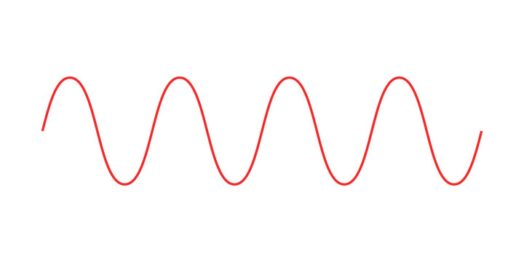
A little more on Consonance and Dissonance
https://academo.org/demos/wave-interference-beat-frequency/

Slide 16
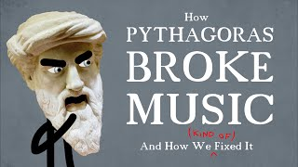
Practical Applications: tuning

Slide 17
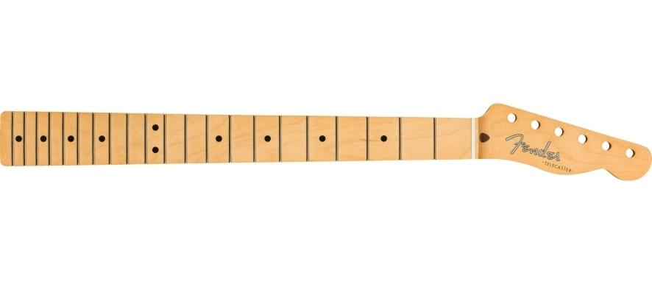
Practical applications: Designing Instruments

Slide 18
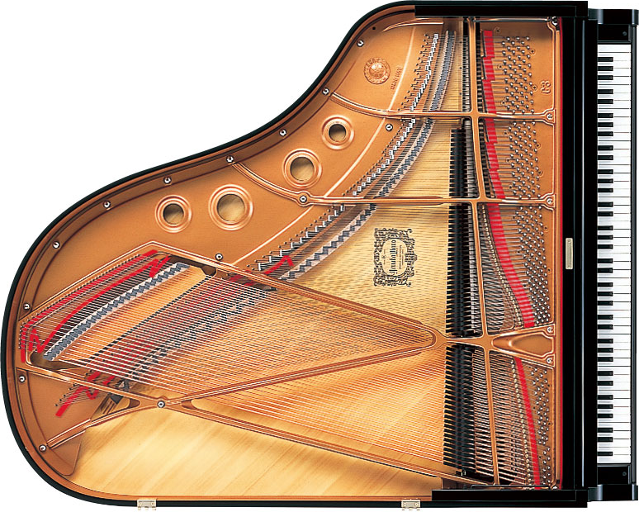
Practical applications: Designing Instruments

Slide 19

Practical applications: A Lyre

Slide 20

Physics, Mathematics, and Music

Slide 21


