Slide 1
Notes:
Book demo to introduce friction

Slide 2
Slipping, Sliding, and Scaling:
The Science of Friction and Inclined Planes

Slide 3
Learning Goals
Find examples of friction in everyday life
Use what we already know about friction to understand new situations
Build intuition about what affects how much friction there is

Slide 4
What Do We Already Know?
Notes:
Have students try dragging block across desks with spring scales
Discuss what they notice
Review static and kinetic friction on flat surfaces
Notice how plot is of the friction coefficient; in this case you can interchangeably plot the coefficient and the force since normal force is constant as you e.g. increase force applied (F_{f} is proportional to μ)

Slide 5
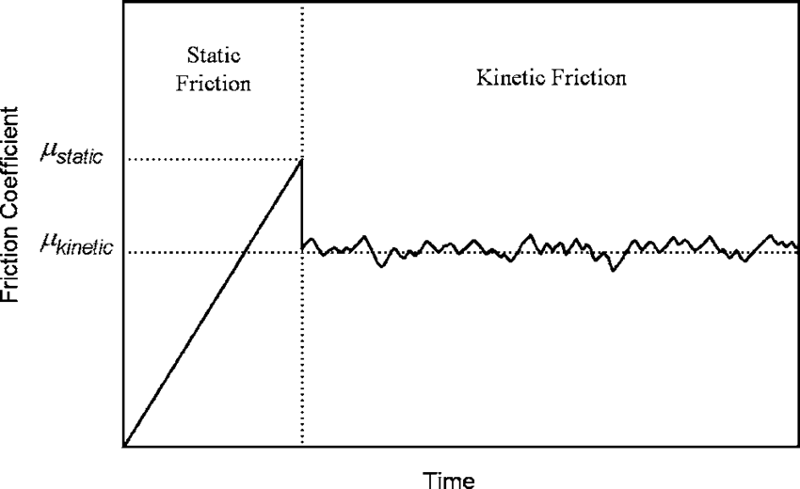
What Do We Already Know?
Notes:
Have students try dragging block across desks with spring scales
Discuss what they notice
Review static and kinetic friction on flat surfaces
Notice how plot is of the friction coefficient; in this case you can interchangeably plot the coefficient and the force since normal force is constant as you e.g. increase force applied (F_{f} is proportional to μ)

Slide 6
What Do We Already Know?
Static friction is an inequality; coefficient μ_{s} is not a constant
F_{s} ≤ μ_{s}F_{N}
Notes:
Have students try dragging block across desks with spring scales
Discuss what they notice
Review static and kinetic friction on flat surfaces
Notice how plot is of the friction coefficient; in this case you can interchangeably plot the coefficient and the force since normal force is constant as you e.g. increase force applied (F_{f} is proportional to μ)

Slide 7
What Do We Already Know?
Static friction is an inequality; coefficient μ_{s} is not a constant
F_{s} ≤ μ_{s}F_{N}
Kinetic friction is always smaller than maximum static friction
F_{k} = μ_{k}F_{N}
Notes:
Have students try dragging block across desks with spring scales
Discuss what they notice
Review static and kinetic friction on flat surfaces
Notice how plot is of the friction coefficient; in this case you can interchangeably plot the coefficient and the force since normal force is constant as you e.g. increase force applied (F_{f} is proportional to μ)

Slide 8
INTRODUCING
Notes:
Use a random combination of block and ramp material, have students predict whether or not the block will slide depending on the varying angle
Review normal force, guide students to realizing how this affects the friction force
Give stationary block a push to show max μ_{s}＞μ_{k}

Slide 9


INTRODUCING
RAMPS
Notes:
Use a random combination of block and ramp material, have students predict whether or not the block will slide depending on the varying angle
Review normal force, guide students to realizing how this affects the friction force
Give stationary block a push to show max μ_{s}＞μ_{k}

Slide 10
Why would increasing the angle of the ramp cause the block to slide?

Slide 11
Friction Depends on Normal Force!
Normal force acts to prevent objects from passing through each other, and will only be as large as necessary to do so.
Notes:
Increasing angle decreases normal force
Recall normal force acts to prevent objects from passing through each other, and will only be as large as necessary to do so
So when it’s on a flat surface, the only way to explain the object not flying into the air or falling through the surface is if the normal force is equal in magnitude to the force of gravity
When an object is on an inclined plane, the normal force is still in the direction normal to the surface, but now is equal in magnitude to only a fraction of the force of gravity
The formula for friction force is __ * normal force
So it follows that with less normal force there is less friction force

Slide 12
Friction Depends on Normal Force!
Normal force acts to prevent objects from passing through each other, and will only be as large as necessary to do so.
F_{N}
F_{g}
Notes:
Increasing angle decreases normal force
Recall normal force acts to prevent objects from passing through each other, and will only be as large as necessary to do so
So when it’s on a flat surface, the only way to explain the object not flying into the air or falling through the surface is if the normal force is equal in magnitude to the force of gravity
When an object is on an inclined plane, the normal force is still in the direction normal to the surface, but now is equal in magnitude to only a fraction of the force of gravity
The formula for friction force is __ * normal force
So it follows that with less normal force there is less friction force

Slide 13
Friction Depends on Normal Force!
Normal force acts to prevent objects from passing through each other, and will only be as large as necessary to do so.
F_{N}
F_{N}
F_{g}
F_{g}
Notes:
Increasing angle decreases normal force
Recall normal force acts to prevent objects from passing through each other, and will only be as large as necessary to do so
So when it’s on a flat surface, the only way to explain the object not flying into the air or falling through the surface is if the normal force is equal in magnitude to the force of gravity
When an object is on an inclined plane, the normal force is still in the direction normal to the surface, but now is equal in magnitude to only a fraction of the force of gravity
The formula for friction force is __ * normal force
So it follows that with less normal force there is less friction force

Slide 14
Friction Depends on Normal Force!
Normal force acts to prevent objects from passing through each other, and will only be as large as necessary to do so.
F_{N}
F_{N}
F_{g}
F_{g}
Notes:
Increasing angle decreases normal force
Recall normal force acts to prevent objects from passing through each other, and will only be as large as necessary to do so
So when it’s on a flat surface, the only way to explain the object not flying into the air or falling through the surface is if the normal force is equal in magnitude to the force of gravity
When an object is on an inclined plane, the normal force is still in the direction normal to the surface, but now is equal in magnitude to only a fraction of the force of gravity
The formula for friction force is __ * normal force
So it follows that with less normal force there is less friction force

Slide 15
Greater Angle, Less Normal Force
F_{N}
F_{N}
F_{g}
F_{g}
Notes:
Increasing angle decreases normal force
Recall normal force acts to prevent objects from passing through each other, and will only be as large as necessary to do so
So when it’s on a flat surface, the only way to explain the object not flying into the air or falling through the surface is if the normal force is equal in magnitude to the force of gravity
When an object is on an inclined plane, the normal force is still in the direction normal to the surface, but now is equal in magnitude to only a fraction of the force of gravity
The formula for friction force is __ * normal force
So it follows that with less normal force there is less friction force

Slide 16
Let’s Race!
 | Block | Track
A | Rubber | Wood
B | Plastic | Carpet
C | Plastic | Rubber
D | Carpet | Cork
Notes:
Have students predict the placement of each combination in the race (+ explain their ranking)
Was there anything unexpected?
Another race where the material on all the blocks is cork

Slide 17
Now What If We Wet the Materials…?
Notes:
Show difference in angle for block with dry vs. wet cork on wood track
How exactly the material’s properties will change depends on its chemical make-up, porosity, etc.
As a rule of thumb, smooth surfaces like tile get more slippery b/c the water (or other lubricant) remains as a layer in between the two materials
Absorbent materials like your skin get more “grippy” (opening a plastic bag example)

Slide 18
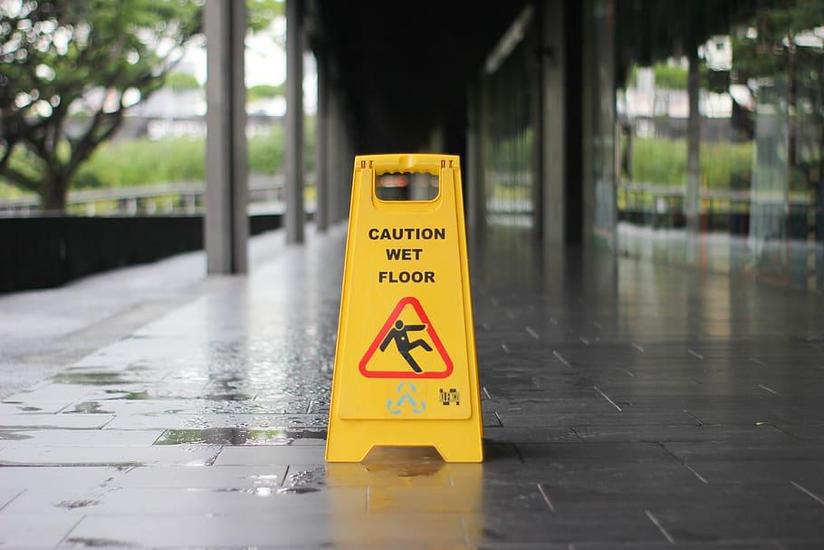
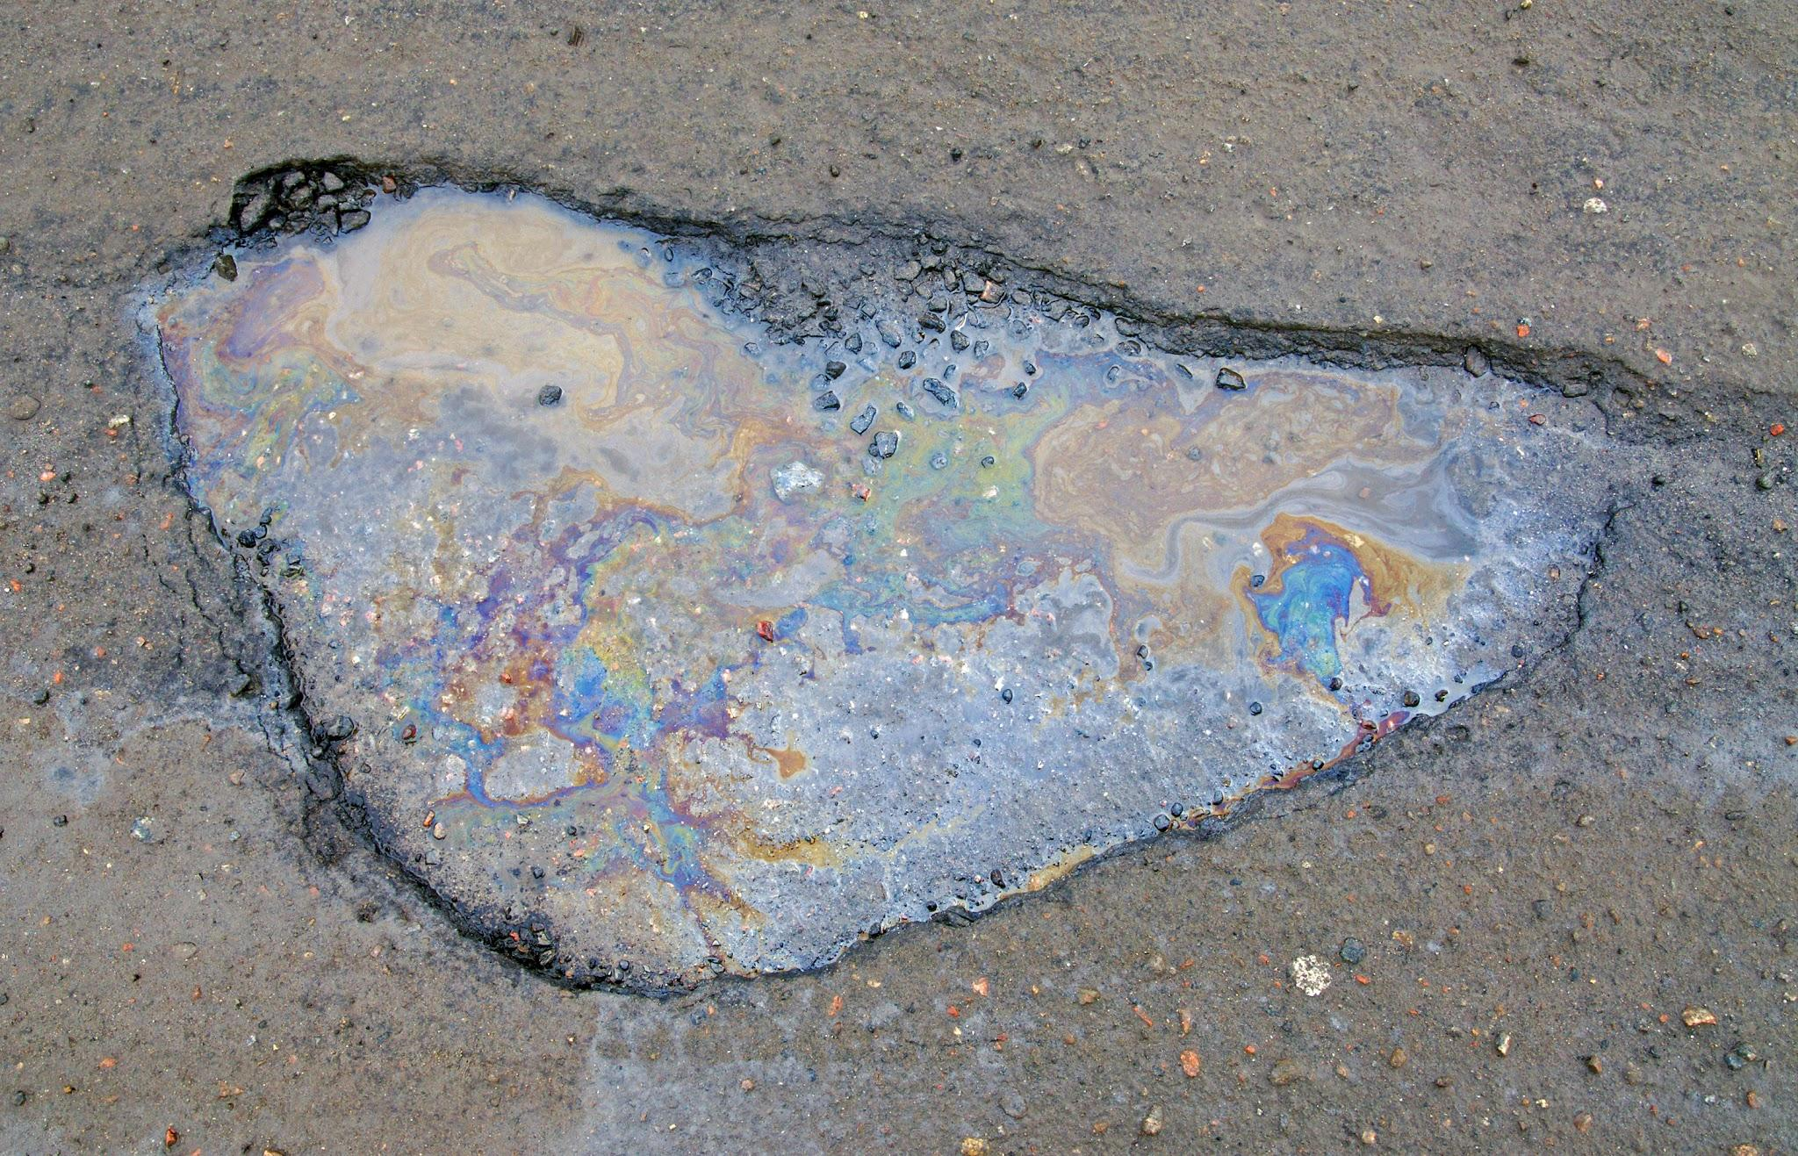
Now What If We Wet the Materials…?
Once we wet the material, we change its properties–including the coefficient of friction between it and another surface!
Notes:
Show difference in angle for block with dry vs. wet cork on wood track
How exactly the material’s properties will change depends on its chemical make-up, porosity, etc.
As a rule of thumb, smooth surfaces like tile get more slippery b/c the water (or other lubricant) remains as a layer in between the two materials
Absorbent materials like your skin get more “grippy” (opening a plastic bag example)

Slide 19
Let’s Get Down to Business 🎵🎵
How we can find the coefficient of friction between two surfaces?
Our Toolkit:
Free Body Diagrams <3
Newton’s 2nd Law of Motion (F_{net} = ma)
Trigonometry
Notes:
Go through toolkit
Emphasize the fact that we are now working in 2 dimensions
F_{net} = ma = F_{g}+ F_{N}= F_{g} + μF_{N} so if we want to isolate for μ…
Hand out Sticky Situation worksheet
Mention you can do this with both kinetic and max static coefficient, but deriving kinetic coefficient will require more equipment like motion sensors
Students pick a material for the block and which track they’d like to use
Measure rise and run of the ramp at the max angle before block starts to slip
Give students some time to try and figure out how they can derive the coefficient

Slide 20
Let’s Get Down to Business 🎵🎵
How we can find the coefficient of friction between two surfaces?
Our Toolkit:
Free Body Diagrams <3
Newton’s 2nd Law of Motion (F_{net} = ma)
Trigonometry
The easiest way to do this is to find the angle where acceleration is zero…
Notes:
Go through toolkit
Emphasize the fact that we are now working in 2 dimensions
F_{net} = ma = F_{g}+ F_{N}= F_{g} + μF_{N} so if we want to isolate for μ…
Hand out Sticky Situation worksheet
Mention you can do this with both kinetic and max static coefficient, but deriving kinetic coefficient will require more equipment like motion sensors
Students pick a material for the block and which track they’d like to use
Measure rise and run of the ramp at the max angle before block starts to slip
Give students some time to try and figure out how they can derive the coefficient

Slide 21
A Useful Trick
y
x
F_{N}
We can redefine our axes!
And that means we must break some of our forces down into x and y components…
θ
F_{gy}
F_{g}
θ
F_{gx}
Notes:
Need F_{net} equations for both x and y directions!
At this point also discuss how we know the two theta angles are the same

Slide 22
There are other types of friction!
But unfortunately we are out of time…
Notes:
Have covered static and sliding friction, but there’s also fluid (e.g. drag in air, water) and rolling friction (e.g. wheels)

Slide 23
Thanks for your attention!

